Slide 1


Bunched Random Forest in Monte Carlo Risk Simulation
Eina Ooka
May, 2017
R/Finance 2017
In Chicago

Slide 2


Power Utility Industry
The Energy Authority serves public utilities nationwide for trading and analytics.
Mid-term (1 month – 5 years) portfolio management.
Stochastic simulation models for energy and gas market.

Slide 3

MC Simulation Approach
Natural Gas
Coal Resources
Natural Gas
Market settlement prices
NG Resources
NG Resources
Power Prices
Power Prices
Power Prices
Power Prices
Runoff/Hydro Forecast
Wind + Solar generation
Load
Load
Hydro generation

Slide 4
MC Simulation Approach
Heston
Natural Gas
Coal Resources
Natural Gas
External Information
Dispatch Simulation
Bunched Random Forest
NG Resources
Market settlement prices
NG Resources
ARIMA
Power Prices
Exogenous Inputs
Power Prices
Power Prices
Power Prices
Markov-Chain
Runoff/Hydro Forecast
Wind + Solar generation
ARIMA
Load
Load
Hydro generation
Optimization

Slide 5
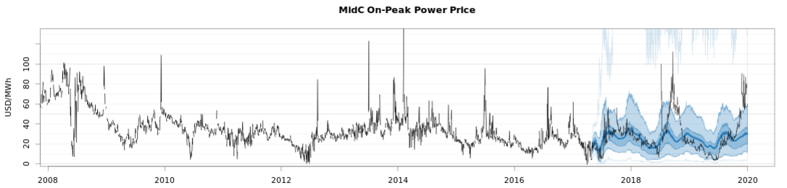
Power Price TS Characteristics
Autocorrelation
Seasonal and weekly shapes
Volatility & Heteroscedasticity
Seasonal and weekly variability
Multivariate cross-correlation and non-linear dependency
NG, load, regional hydro and other variable generation
Non-normal distributions
fat tails
Extreme peaks and drops
Negative prices
Consistency with market expectations
Consistency between monthly, daily and hourly data.

Slide 6
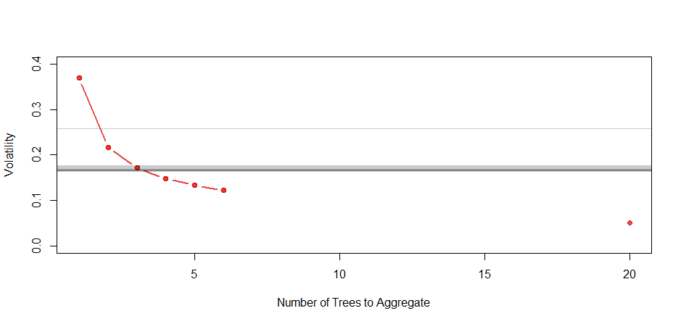
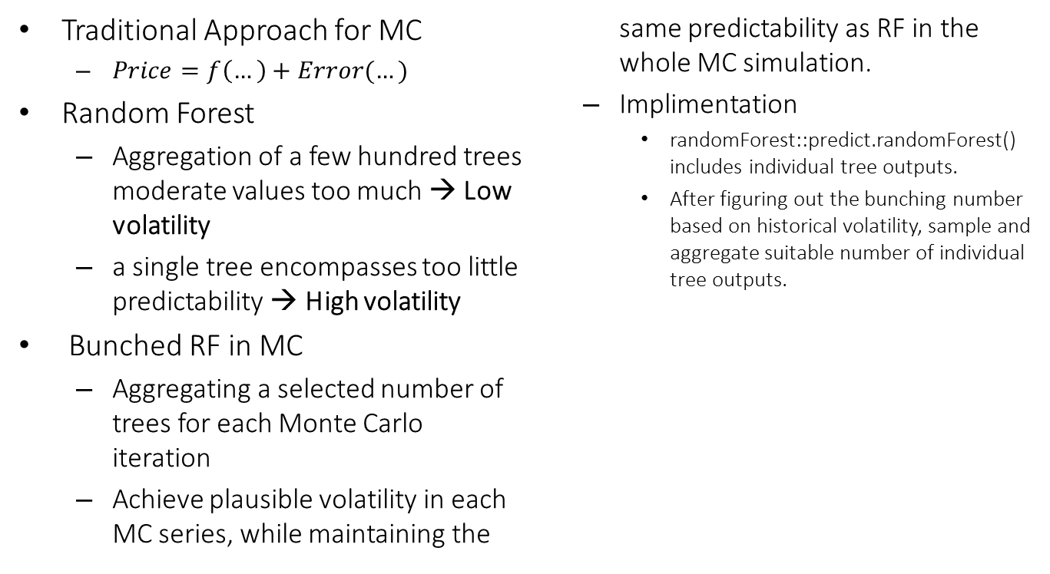
Bunched Random Forest
Traditional Approach for MC
$Price=f\left(…\right)+Error(…)$
Random Forest
Aggregation of a few hundred trees moderate values too much → Low volatility
a single tree encompasses too little predictability → High volatility
Bunched RF in MC
Aggregating a selected number of trees for each Monte Carlo iteration
Achieve plausible volatility in each MC series, while maintaining the same predictability as RF in the whole MC simulation.
Implimentation
randomForest::predict.randomForest() includes individual tree outputs.
After figuring out the bunching number based on historical volatility, sample and aggregate suitable number of individual tree outputs.
Simulated
Historical
… 300

Slide 7
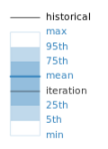
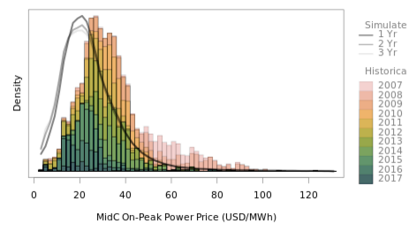
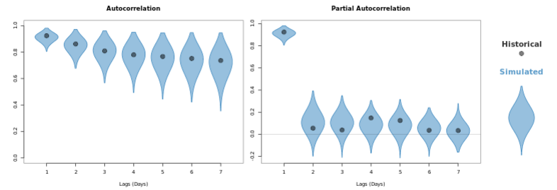
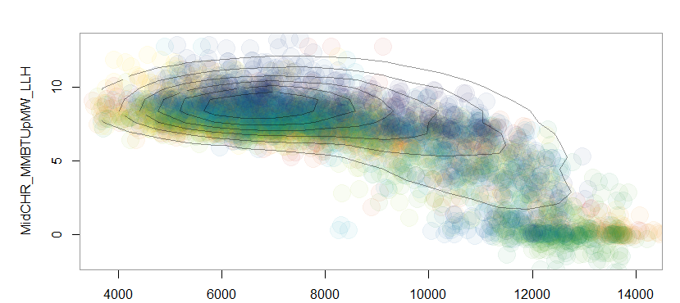
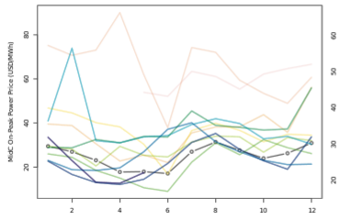
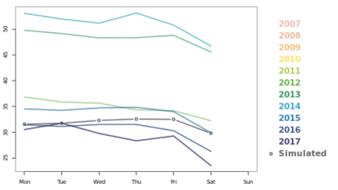
Results
Mid-C Power Price (Historical + Simulated)
Price Distribution
Autocorrelation
MidC Power Heat Rate (mmBtu/MWh)
Seasonality
Weekly Shape
Non-linear dependency on regional hydro
Regional Hydro Generation (aMW)

Slide 8
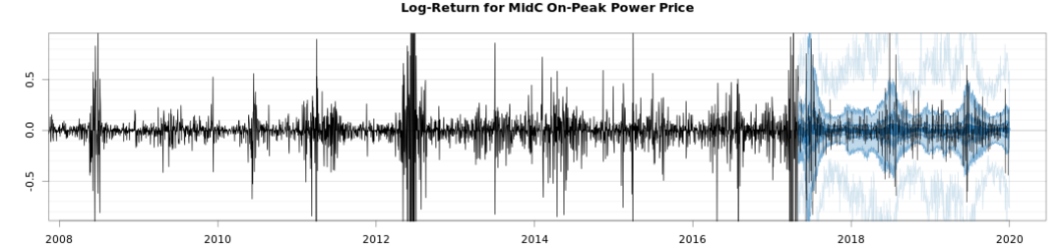
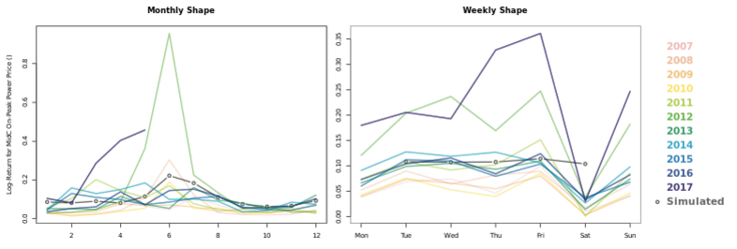
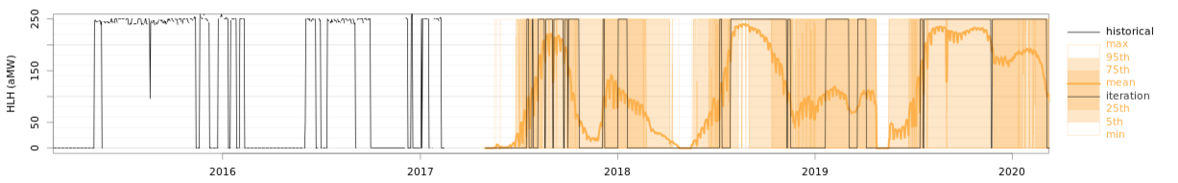
Results
Power Price Log-Returns (Historical + Simulated)
Scoring
Pinball-loss scoring for stochastic forecasting
Need to achieve all time series characteristics.
Volatility, seasonality, moments, …
A visual inspection with heuristic reasoning is sometimes necessary.
Backcast and feed the generated power prices to Natural Gas dispatch model, and look at pinball-loss scoring on generation outputs.
Seasonality in Volatility
Natural Gas Resource Dispatch (Historical + Simulated)

Slide 9

More on utility portfolio modeling on my poster from
UseR 2016:
https://github.com/
einaooka/useR2016
Thank you!
Contact:
eooka@teainc.org
! The Energy Authority is looking for an intern.

